Slide 1
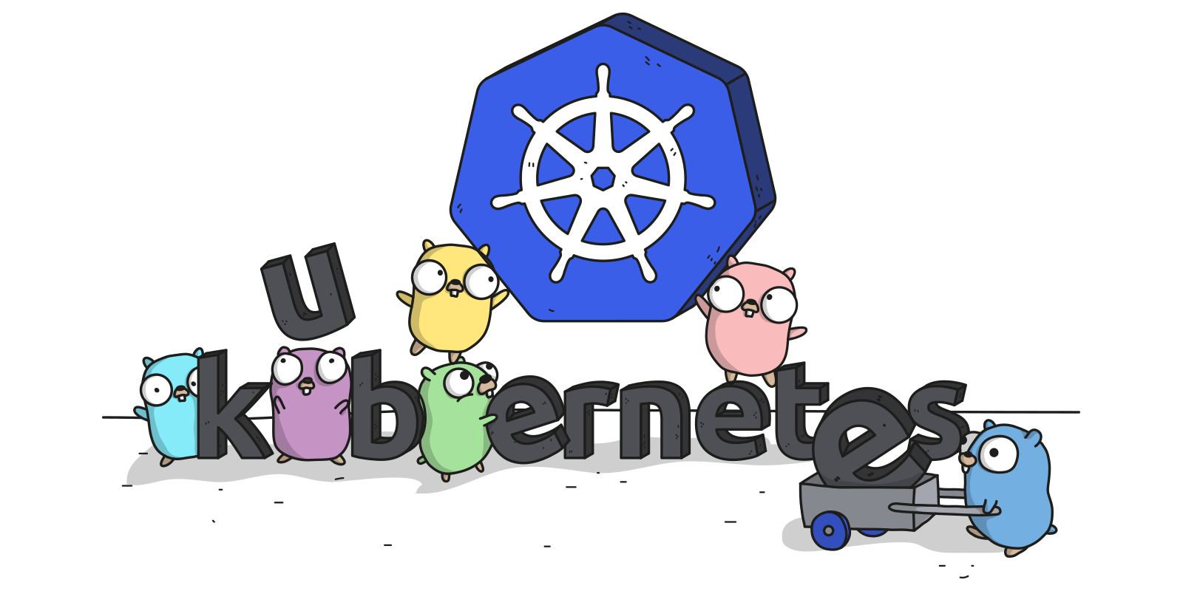
Kubernetes 101 “Hands On” Workshop
Lucas Käldström - CNCF Ambassador
29th of October, 2019 - Tampere
Image credit: @ashleymcnamara

Slide 3


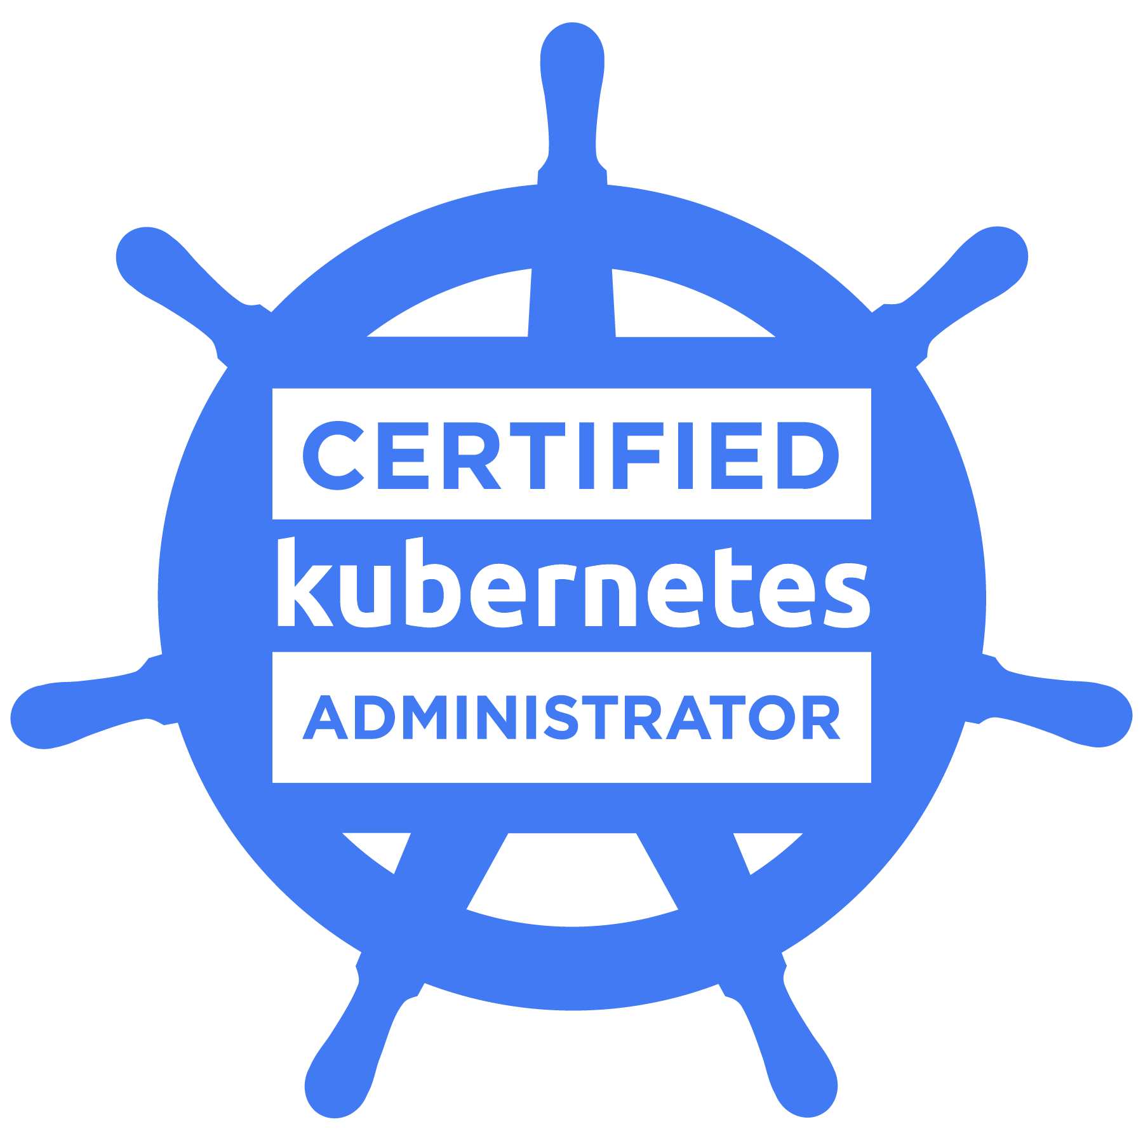

$ whoami
Lucas Käldström, freshman Student at Aalto, 20 yo
CNCF Ambassador, Certified Kubernetes Administrator and Kubernetes WG/SIG Lead
KubeCon Speaker in Berlin, Austin,
Copenhagen, Shanghai, Seattle & San Diego
KubeCon Keynote Speaker in Barcelona
Kubernetes approver and subproject owner (formerly maintainer), active in the community for 4+ years. Got kubeadm to GA.
Weave Ignite author, written this summer

Slide 4
An intro to CNCF
Cloud Native Computing Foundation helps us all succeed

Slide 5
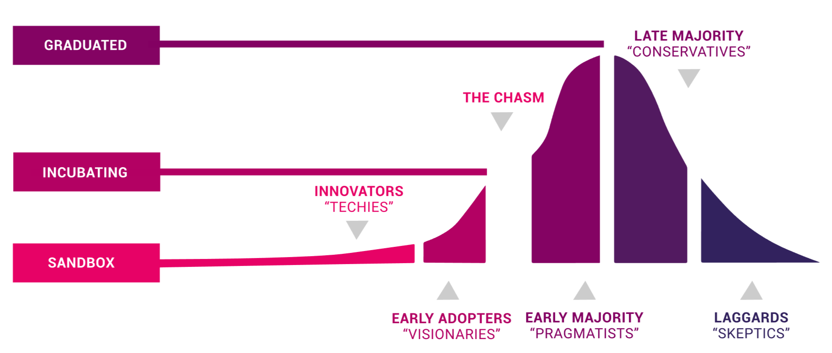
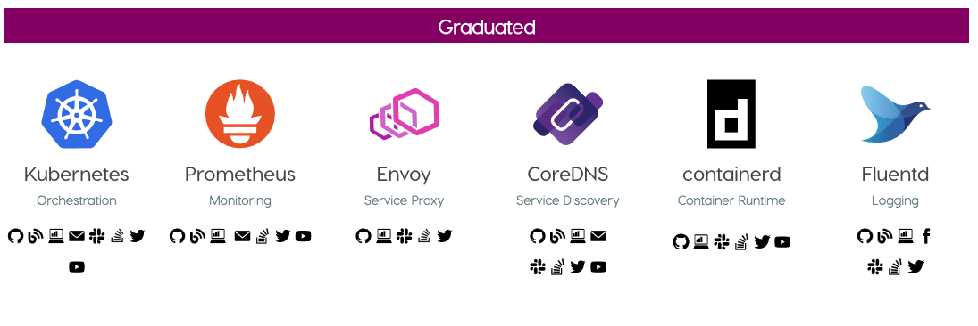
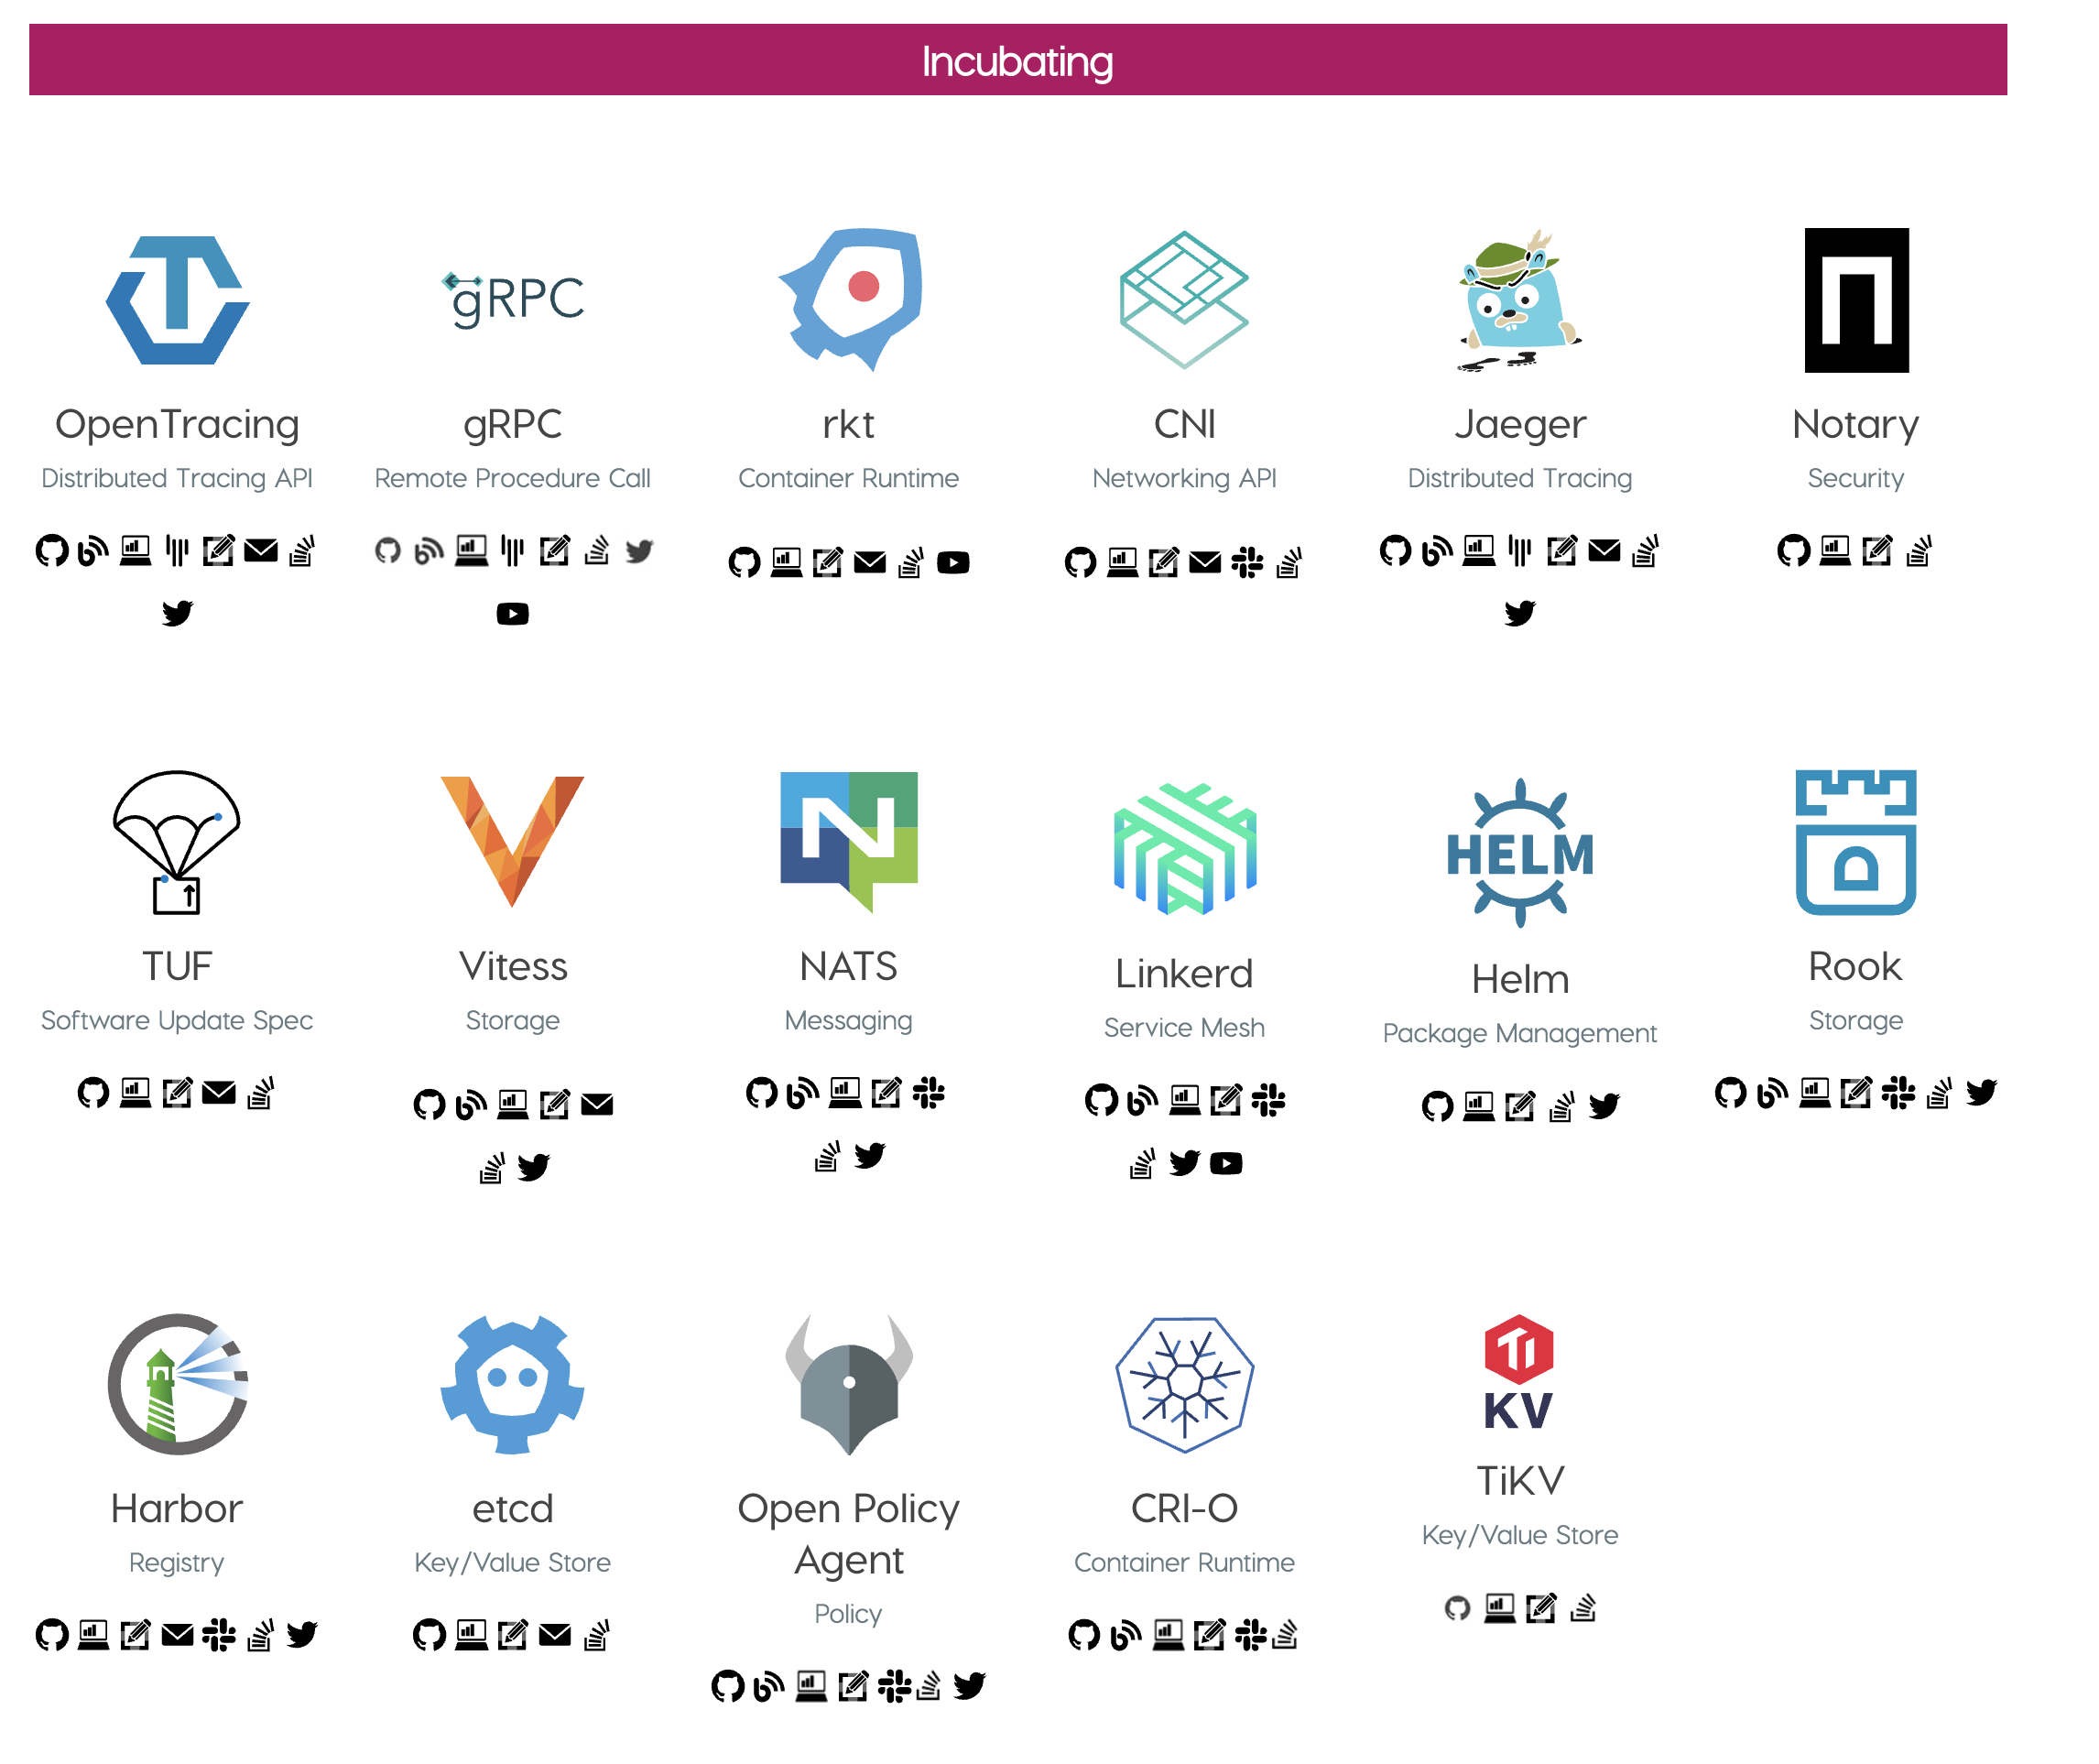
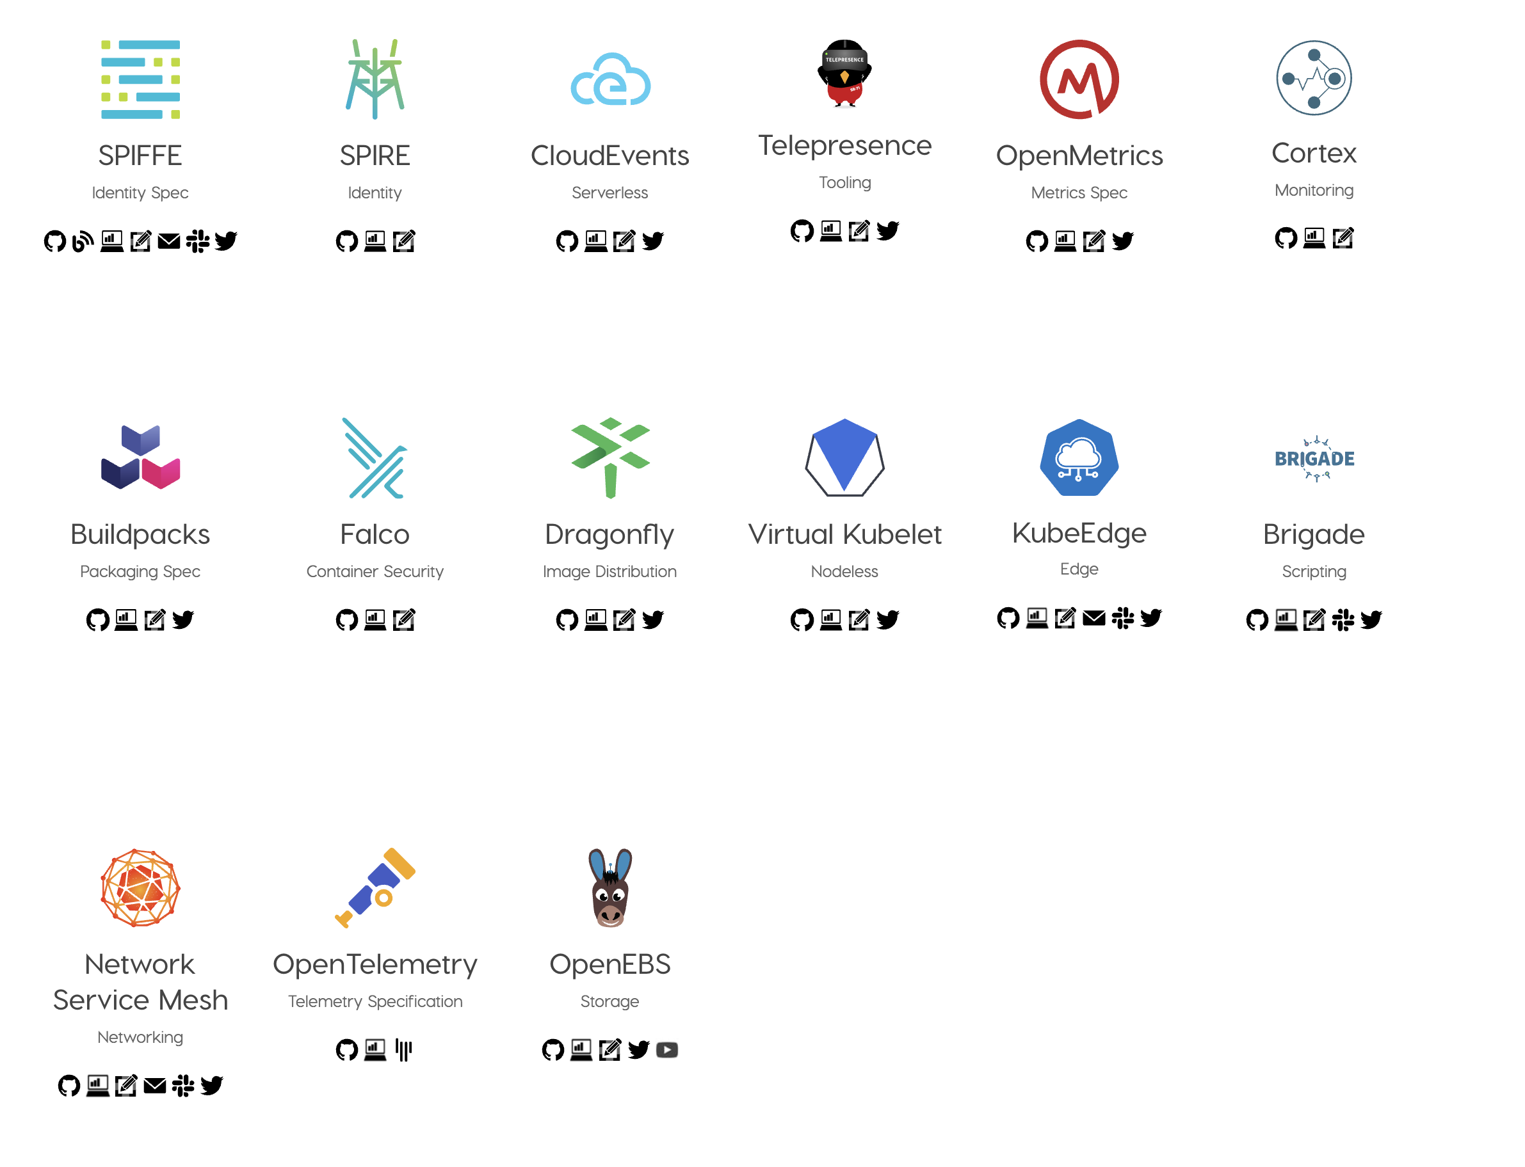
CNCF Projects

Slide 6
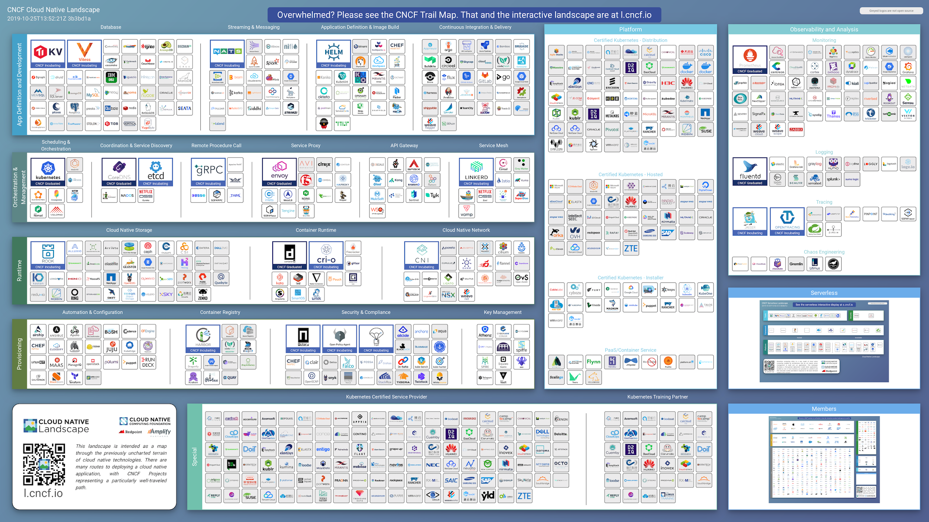

Slide 7
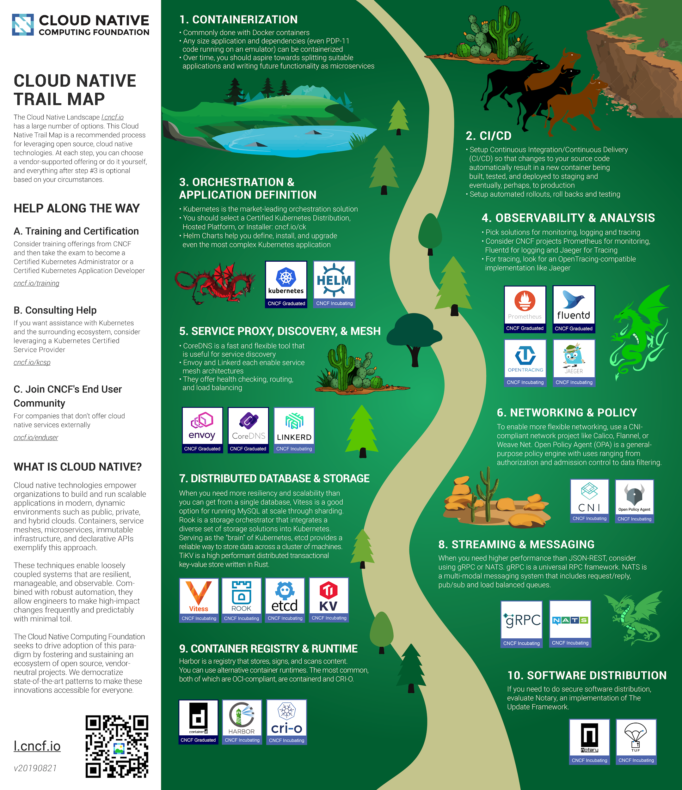
Cloud Native Trail Map
Trail Map: l.cncf.io

Slide 8
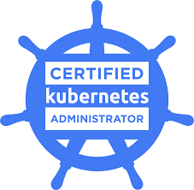
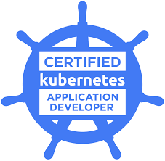


Training and Certification
Training
Certification
Over 88,000 people have registered for the free Introduction to Kubernetes course on edX
Over 9,800 people have registered for the $299 Kubernetes Fundamentals course
Over 10,600 people have registered for the Certified Kubernetes Administrator (CKA) online test
Over 4,000 people have registered for the Certified Kubernetes Application Developer (CKAD) online test

Slide 9
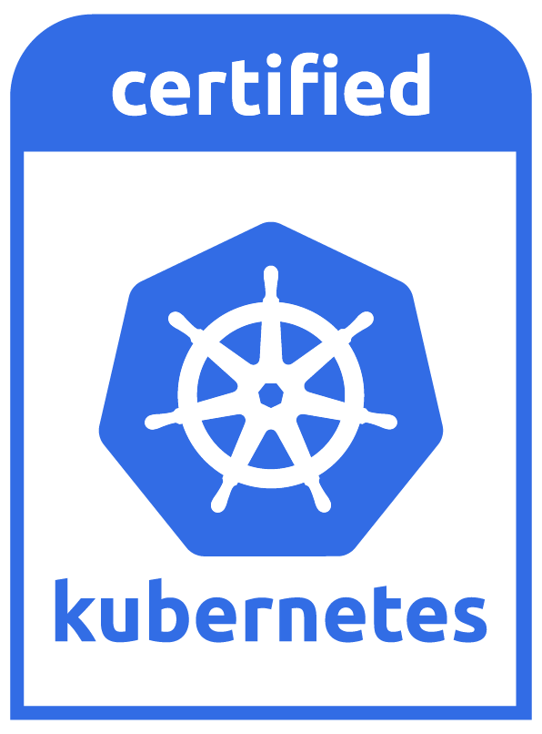
Certified Kubernetes Conformance
CNCF runs a software conformance program for Kubernetes
Implementations run conformance tests and upload results
New mark and more flexible use of Kubernetes trademark for conformant implementations
cncf.io/ck
Source

Slide 10
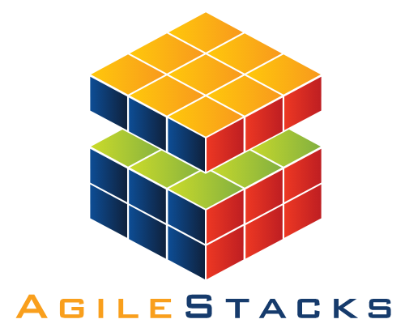

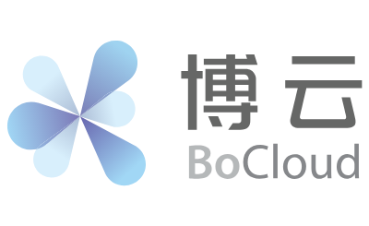





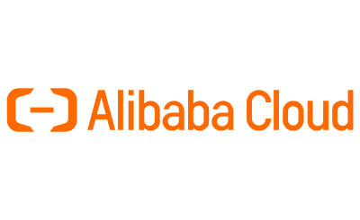





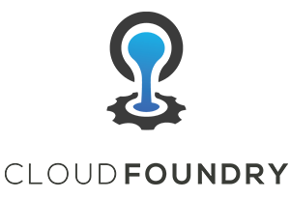



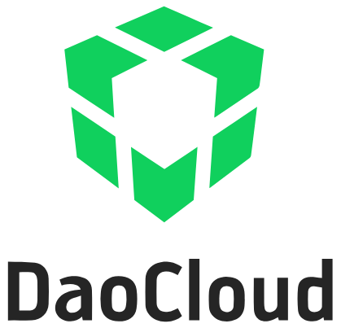

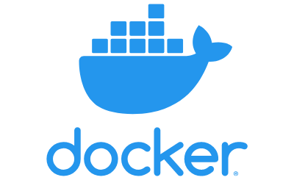










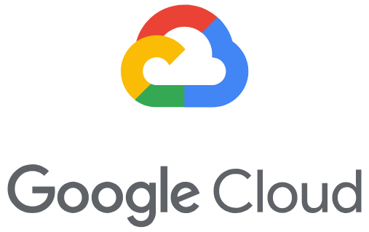

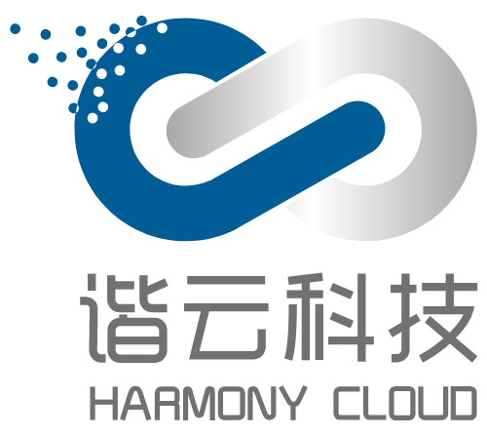



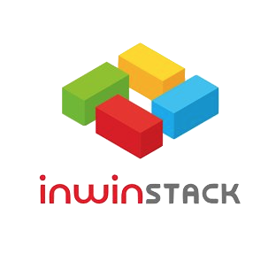


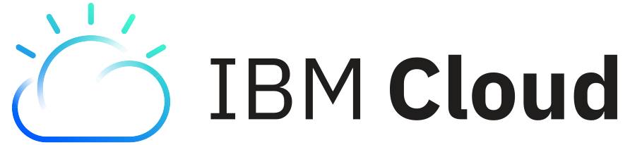

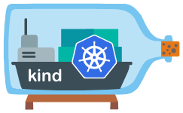

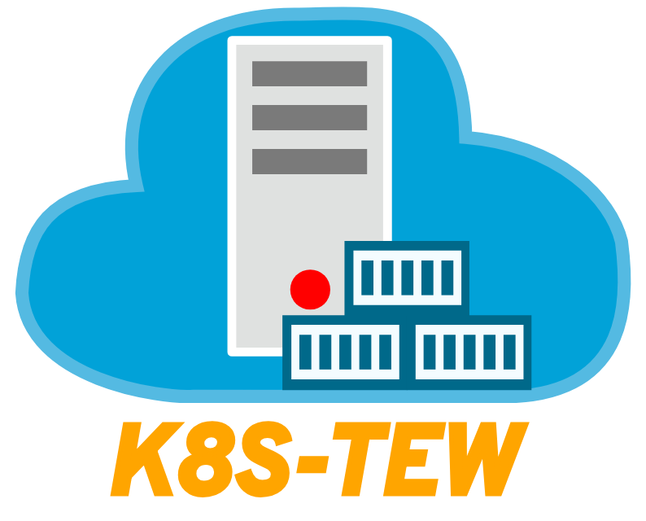


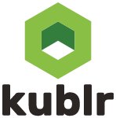
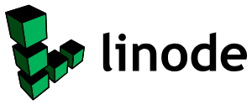


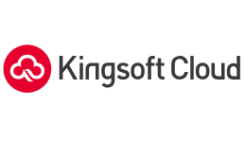

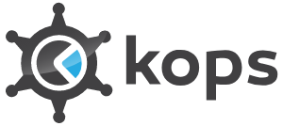



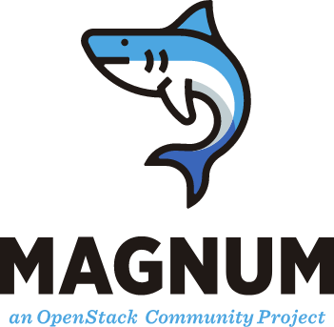





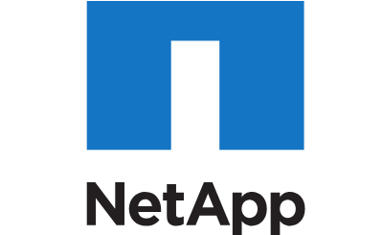
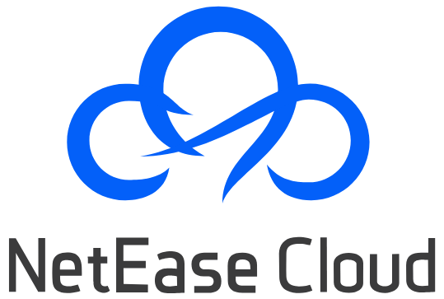
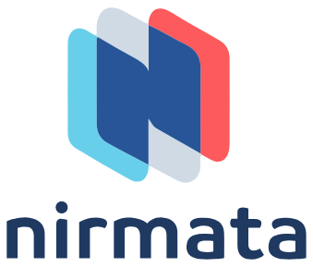











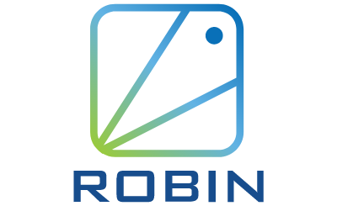
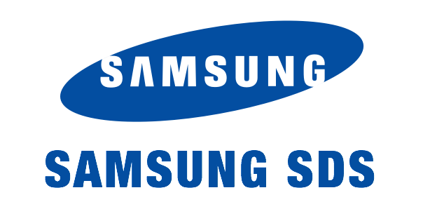






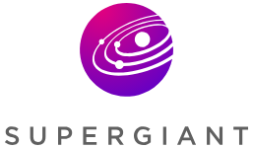



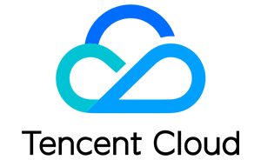


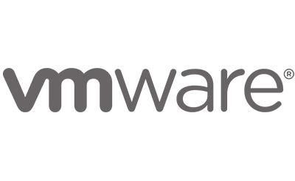


97 Certified Kubernetes Partners

Slide 11
Kubernetes on a high-level
Kubernetes lets you efficiently & declaratively manage your apps at any scale

Slide 12
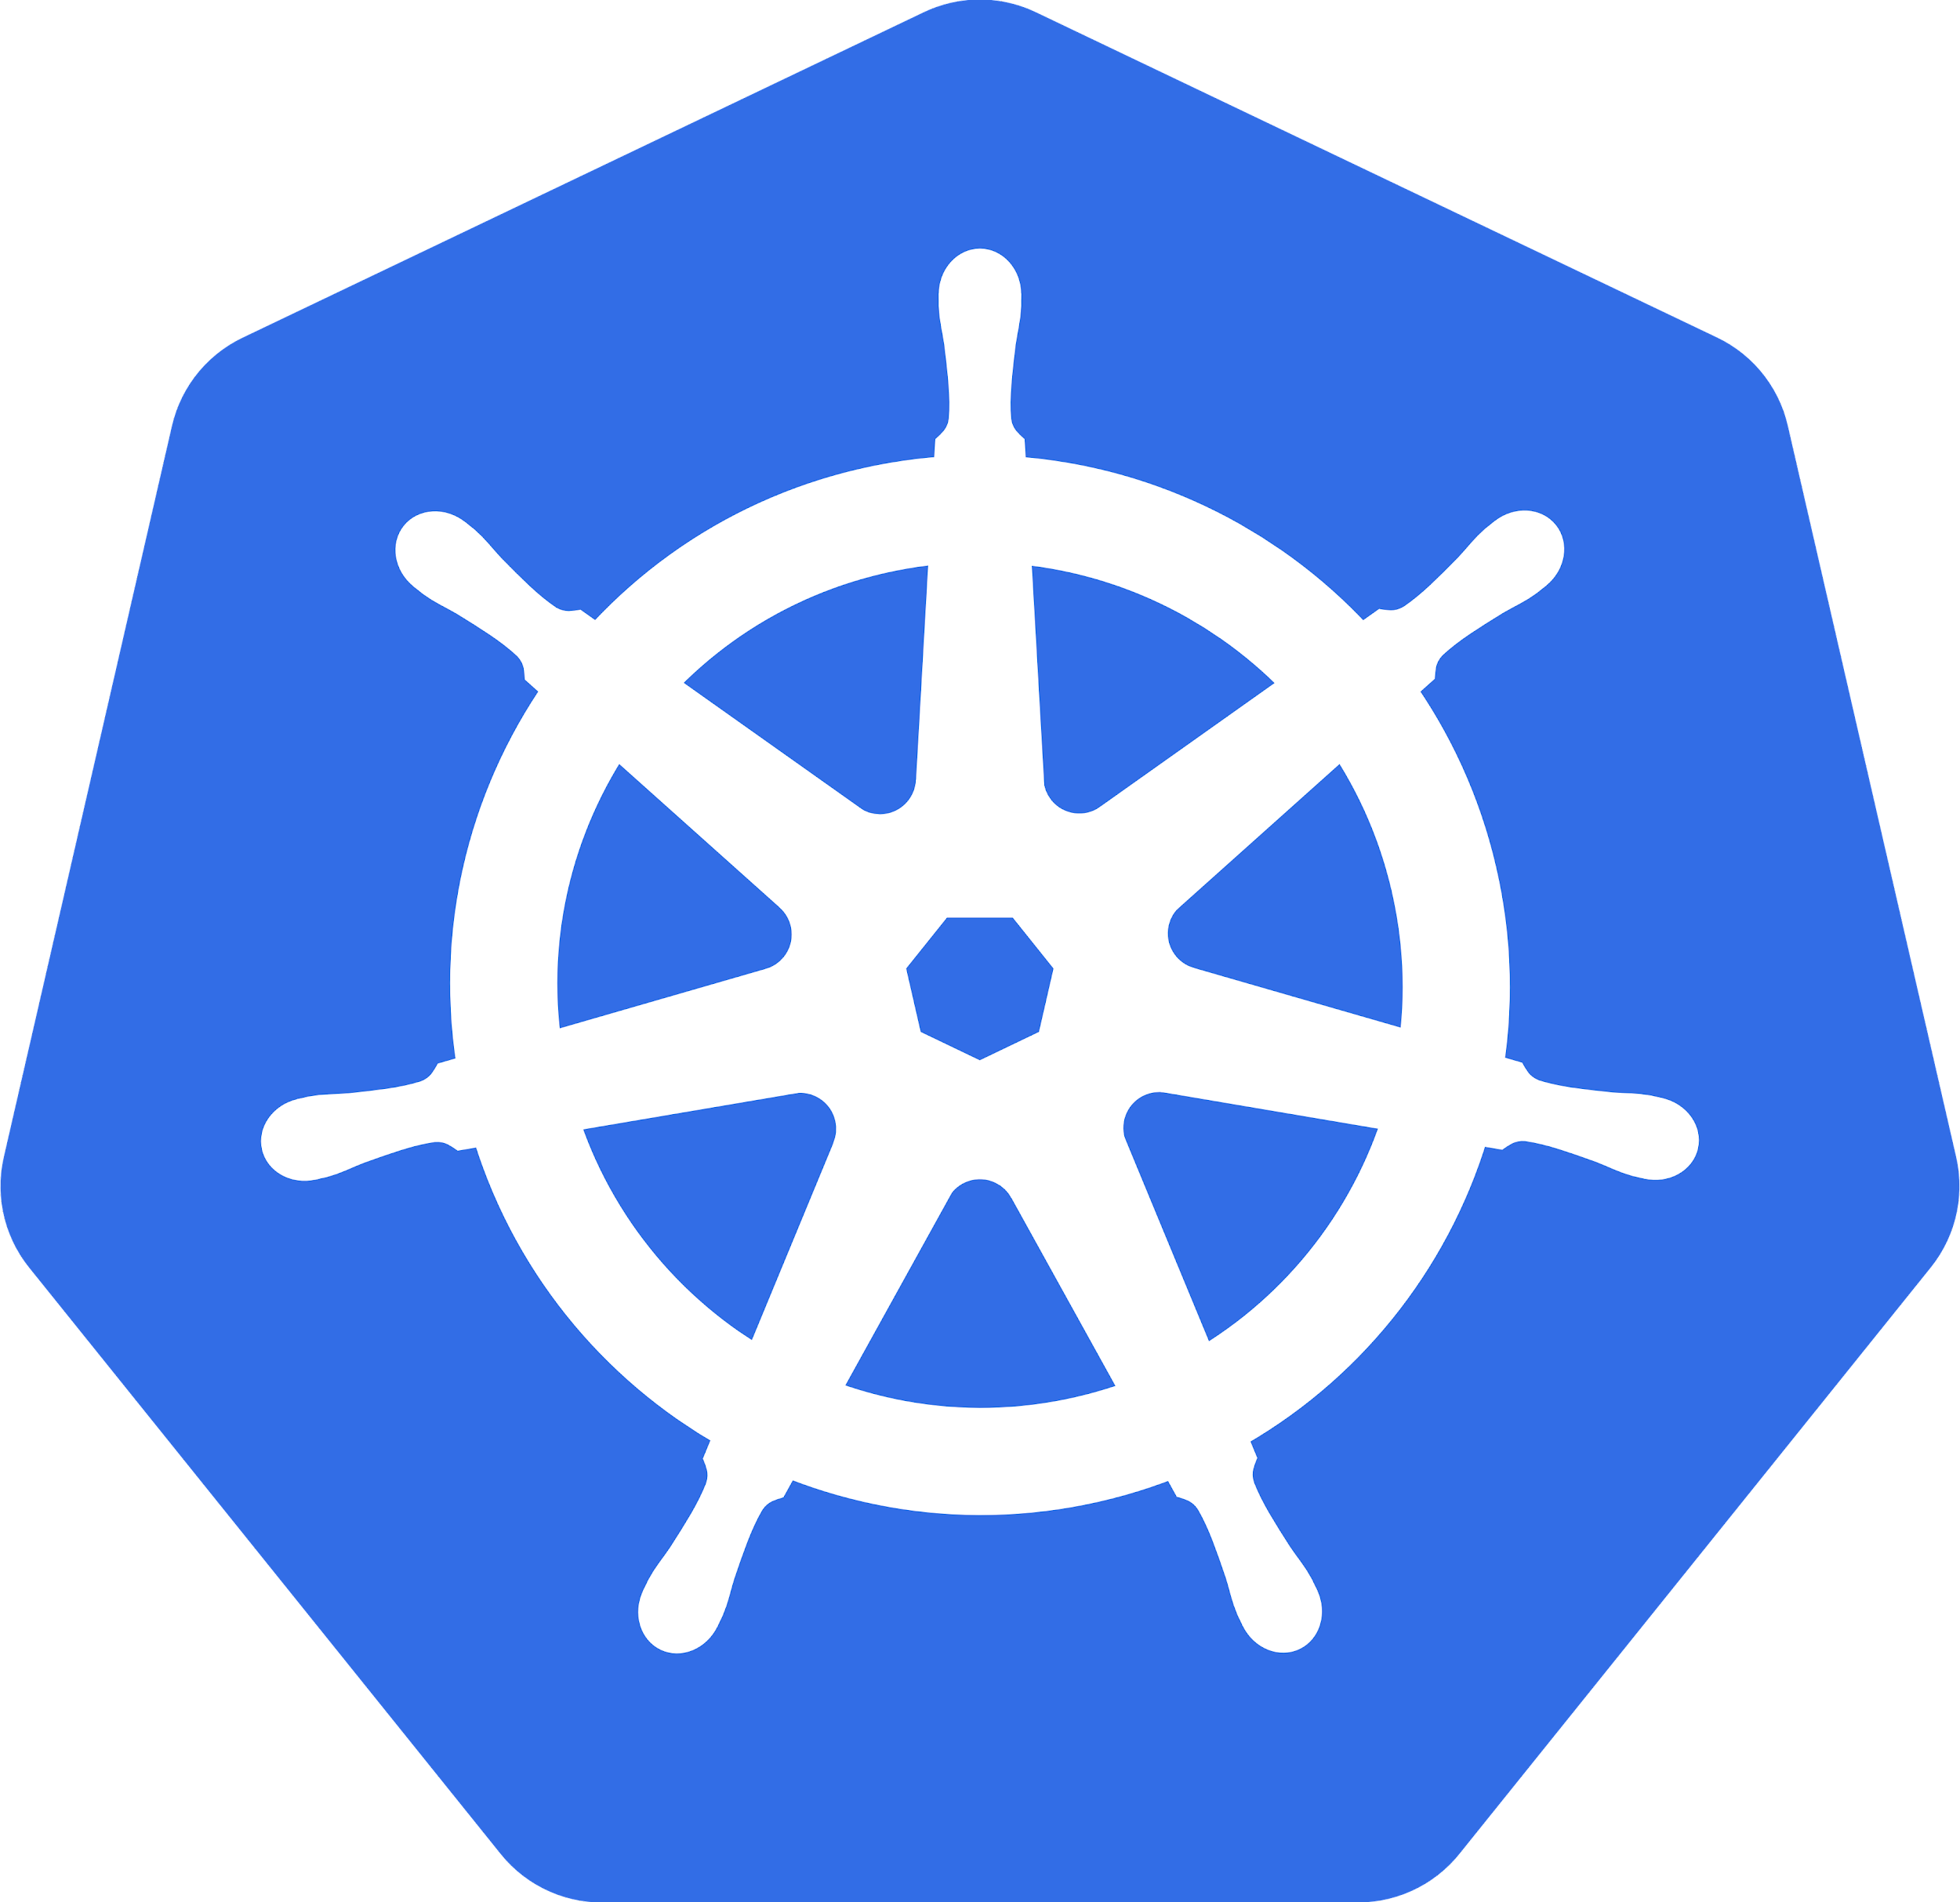
Most importantly: What does “Kubernetes” mean?
= Greek for “pilot” or “helmsman of a ship”

Slide 13
What is Kubernetes?
= A Production-Grade Container Orchestration System
A project that was spun out of Google as an open source container orchestration platform.
Built from the lessons learned in the experiences of developing and running Google’s Borg and Omega.
Designed from the ground-up as a loosely coupled collection of components centered around deploying, maintaining and scaling workloads.
Notes:
There’s a phrase called Google-scale. This was developed out of a need to scale large container applications across Google-scale infrastructure
borg is the man behind the curtain managing everything in google
Kubernetes is loosely coupled, meaning that all the components have little knowledge of each other and function independently.
This makes them easy to replace and integrate with a wide variety of systems

Slide 14
What Does Kubernetes do?
Known as the linux kernel of distributed systems.
Abstracts away the underlying hardware of the nodes and provides a uniform interface for workloads to be both deployed and consume the shared pool of resources.
Works as an engine for resolving state by converging actual and the desired state of the system.
Notes:
linux kernel of distributed systems
Sort of like a hypervisors, in that it abstracts away the underlying host resources and shares them in a normalized way.
the underlying substrate or platform to build your applications and tools on top of
Think of Kubernetes like a higher-level language for your application architecture.
you describe what you need and it tries to resolve it
with that in mind, it acts as an engine to resolve state using the abstracted resources to deploy and manage your application.
It is declarative, and not imperative. You tell it or “declare” what you want, and it figures out the rest.
imperative you tell something every step you want it to do
declarative you tell it what you want it to be, and it figures it out
e.g. ‘I want 5 instances of x’ and it just does it, if something dies, it brings it back to get to 5

Slide 15
Kubernetes is self-healing
Kubernetes will ALWAYS try and steer the cluster to its desired state.
Me: “I want 3 healthy instances of redis to always be running.”
Kubernetes: “Okay, I’ll ensure there are always 3 instances up and running.”
Kubernetes: “Oh look, one has died. I’m going to attempt to spin up a new one.”
Notes:
The instance will have a new IP and likely be on a different host, but Kubernetes gives the primitives for us to ‘not care’ about that.

Slide 16
What can Kubernetes REALLY do?
Autoscale Workloads
Blue/Green Deployments
Fire off jobs and scheduled CronJobs
Manage Stateless and Stateful Applications
Provide native methods of service discovery
Easily integrate and support 3rd party apps
Notes:
Everything here requires some level of configuration

Slide 17

Most Importantly...
Use the SAME API across bare metal and EVERY cloud provider!!!
Notes:
Single biggest value-add Kubernetes can offer

Slide 18
Kubernetes’ incredible velocity (last 365 days!)
32 000+
human commits
15 000+
contributors
50 000+
edX course enrolls
55 000+
users on Slack
51 000+
opened Pull Requests
318 000+
Github comments
35 000+ Kubernetes jobs
73 000+
opened issues
88 000+
Kubernetes professionals
Last updated: 09.01.2019
Source 1
Source 2
Source 3
Source 4
Source 5

Slide 19
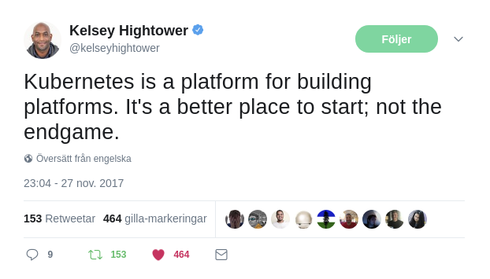
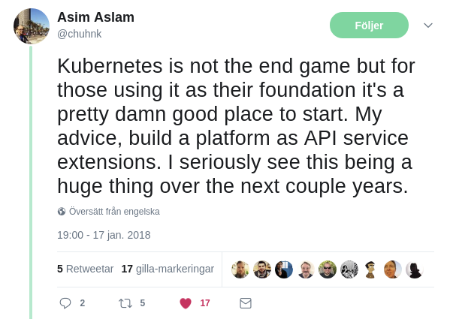
Kubernetes is a “platform for platforms”
Documentation on how to extend Kubernetes
Kubernetes is meant to be built on top of, and hence is very focused on being extensible for higher-level solutions
To name a few extension mechanisms:
API Aggregation (GA)
kubectl plugins (beta)
CustomResourceDefinitions, Example intro (beta)
Container Network Interface plugins (stable)
Scheduler webhook & multiple (beta)
Device plugins (GA)
Admission webhooks (beta)
External Cloud Provider Integrations (beta)
API Server authn / authz webhooks (stable)
Container Runtime Interface plugins (alpha)
Container Storage Interface plugins (GA)

Slide 20
Kubernetes’ Architecture

Slide 21

Kubernetes’ high-level component architecture
Control Plane
etcd (key-value DB, SSOT)
Controller Manager
(Controller Loops)
Scheduler
(Bind Pod to Node)
User
API Server (REST API)
Nodes
Legend:
CNI
CRI
OCI
Protobuf
gRPC
JSON
Node 1
Node 2
Node 3
Networking
Networking
Networking
Kubelet
Kubelet
Kubelet
Container
Runtime
Container
Runtime
Container
Runtime
OS
OS
OS
Notes:
Say “This is what Kubernetes’ architecture looks like on a high level -- we’ll dive into a couple more detailed diagrams like this later”
Don’t say “You’re probably familiar with this arch diagram already” -> I’m here to tell the attendee what this is

Slide 22

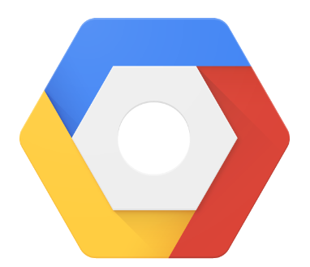

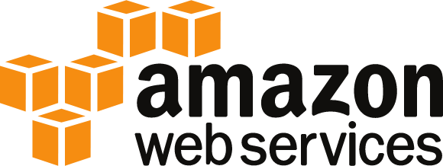
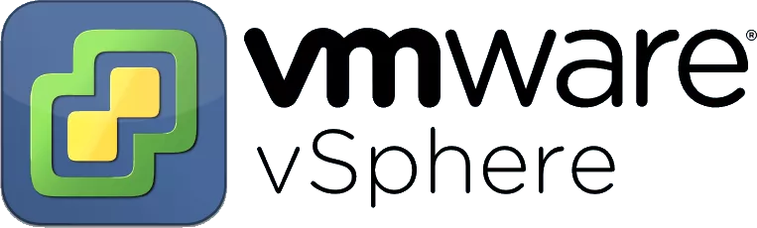
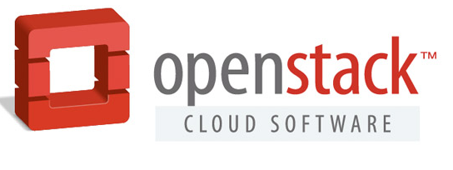
kubeadm
= A tool that sets up a minimum viable, best-practice Kubernetes cluster
Cluster API
Cluster API Spec
Cluster API Implementation
Layer 3
Addons
Cloud Provider
Load Balancers
Monitoring
Logging
Kubernetes API
Layer 2
The scope of kubeadm
Bootstrapping
kubeadm
kubeadm
kubeadm
kubeadm
Machines
Master 1
Master N
Node 1
Node N
Layer 1
Infrastructure

Slide 23
kubeadm vs kops or kubespray
Two different projects, two different scopes
kops
Cluster API
Cluster API Spec
Cluster API Implementation
Addons
Cloud Provider
Load Balancers
Monitoring
Logging
Kubernetes API
Bootstrapping
kubeadm
kubeadm
kubeadm
kubeadm
Machines
Master 1
Master N
Node 1
Node N
Infrastructure

Slide 24
kube-apiserver, the heart of the cluster
Provides a forward facing REST interface into the Kubernetes control plane and datastore.
All clients and other applications interact with Kubernetes strictly through the API Server.
Acts as the gatekeeper to the cluster by handling authentication and authorization, request validation, mutation, and admission control in addition to being the front-end to the backing datastore.
Notes:
provides forward facing REST interface into k8s itself
everything, ALL components interact with each other through the api-server
handles authn, authz, request validation, mutation and admission control and serves as a generic front end to the backing datastore

Slide 25

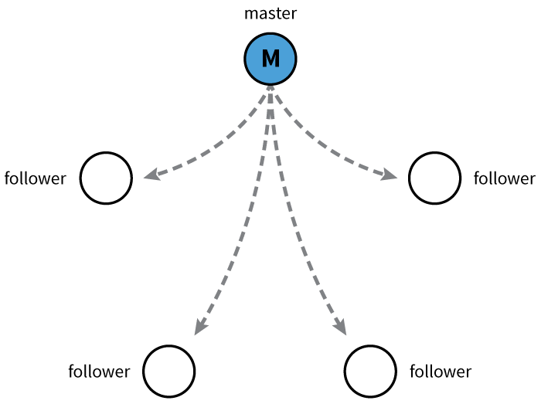
etcd, the key-value datastore
etcd acts as the cluster datastore.
A standalone incubating CNCF project
Purpose in relation to Kubernetes is to provide a strong, consistent and highly available key-value store for persisting all cluster state.
Uses “Raft Consensus” among a quorum of systems to create a fault-tolerant consistent “view” of the cluster.
Notes:
is the backing datastore
extremely durable and highly available key-value store
was developed originally by coreos now redhat
however it is in the process of being donated to the CNCF

Slide 26
kube-controller-manager, the reconciliator
Serves as the primary daemon that manages all core components’ reconcilation loops.
Handles a lot of the business logic of Kubernetes.
Monitors the cluster state via the API Server and steers the cluster towards the desired state.
List of core controllers
Notes:
Its the director behind the scenes
The thing that says “hey I need a few more pods spun up”
Does NOT handle scheduling, just decides what the desired state of the cluster should look like
e.g. receives request for a deployment, produces replicaset, then produces pods

Slide 27
kube-scheduler, the placement engine
Verbose policy-rich engine that evaluates workload requirements and attempts to place it on a matching resource.
The default scheduler uses the “binpacking” mode.
Workload Requirements can include: general hardware requirements, affinity/anti-affinity, labels, and other various custom resource requirements.
Is swappable, you can create your own scheduler
Notes:
scheduler decides which nodes should run which pods
updates pod with a node assignment, nodes poll checking which pods have their matching assignment
takes into account variety of reqs, affinity, anti-affinity, hw resources etc
possible to actually run more than one scheduler
example: kube-batch is a gang scheduler based off LSF/Symphony from IBM

Slide 28
kubelet, the node agent
Acts as the node agent responsible for managing the lifecycle of every pod on its host.
Kubelet understands JSON/YAML container manifests that it can read from several sources:
Watching the API server (the primary mode)
A directory with files
A HTTP Endpoint
HTTP Server mode accepting container manifests over a simple API.
Notes:
the single host daemon required for a being a part of a kubernetes cluster
can read pod manifests from several different locations
workers: poll kube-apiserver looking for what they should run
masters: run the master services as static manifests found locally on the host

Slide 29
Container Runtime
A container runtime is a CRI (Container Runtime Interface) compatible application that executes and manages containers.
Docker (default, built into the kubelet atm)
containerd
cri-o
rkt
Kata Containers (formerly clear and hyper)
Virtlet (VM CRI compatible runtime)
Notes:
Kubernetes functions with multiple different containerizers
Interacts with them through the CRI - container runtime interface
CRI creates a ‘shim’ to talk between kubelet and the container runtime
cri-o is a cool one that allows you to run any oci compatible image/runtime in Kubernetes
kata is a super lightweight KVM wrapper

Slide 30
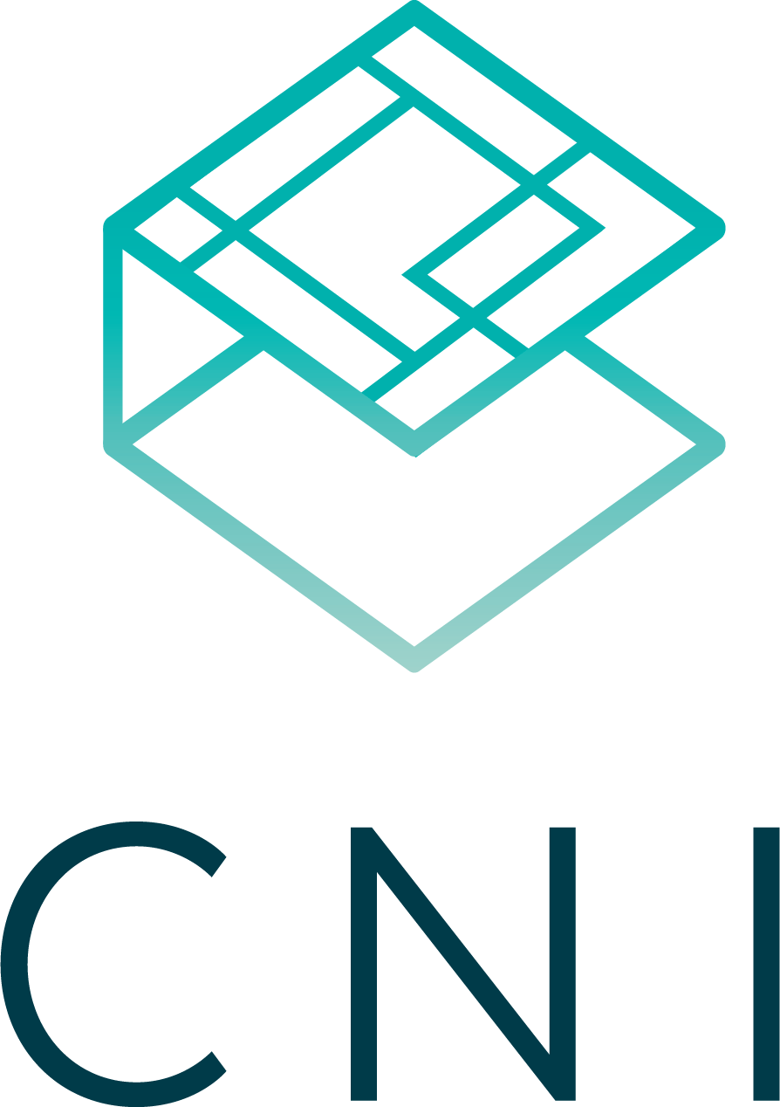
Container Network Interface (CNI)
Pod networking within Kubernetes is plumbed via the Container Network Interface (CNI).
Functions as an interface between the container runtime and a network implementation plugin.
CNCF Project
Uses a simple JSON Schema.
Notes:
Covering this as its a requirement if bootstrapping your own cluster
Container runtime in this context is a linux network namespace
CNI runtime focuses solely on container lifecycle connectivity
add and delete network

Slide 31
Kubernetes Networking
Pod Network (third-party implementation)
Cluster-wide network used for pod-to-pod communication managed by a CNI (Container Network Interface) plugin.
Service Network (kube-proxy)
Cluster-wide range of Virtual IPs managed by kube-proxy for service discovery.
Notes:
Unlike Docker, every pod gets its own cluster wide unique IP, and makes use of the CNI plugin
Services are a separate range of static non-routable virtual IPs that are used like an internal LB or static IP
Service IPs are special and can’t be treated like a normal IP, they are a ‘mapping’ stored and managed by kube-proxy
Pod IPs are pingable
Service IPs are not

Slide 32
kube-proxy, the Service proxier
Manages the network rules for Services on each node.
Performs connection forwarding or load balancing for Kubernetes Services.
Available Proxy Modes:
ipvs (default if supported)
iptables (default fallback)
userspace (legacy)
Notes:
kube-proxy is the plumber
creates the rules on the host to map and expose services
uses a combination of ipvs and iptables to manage networking/loadbalancing
ipvs is more performant and opens the door to a wider feature set (port ranges, better lb rules etc)

Slide 33

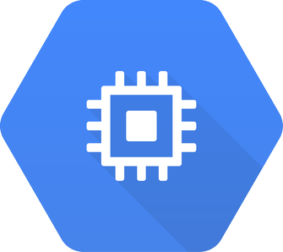







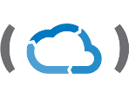

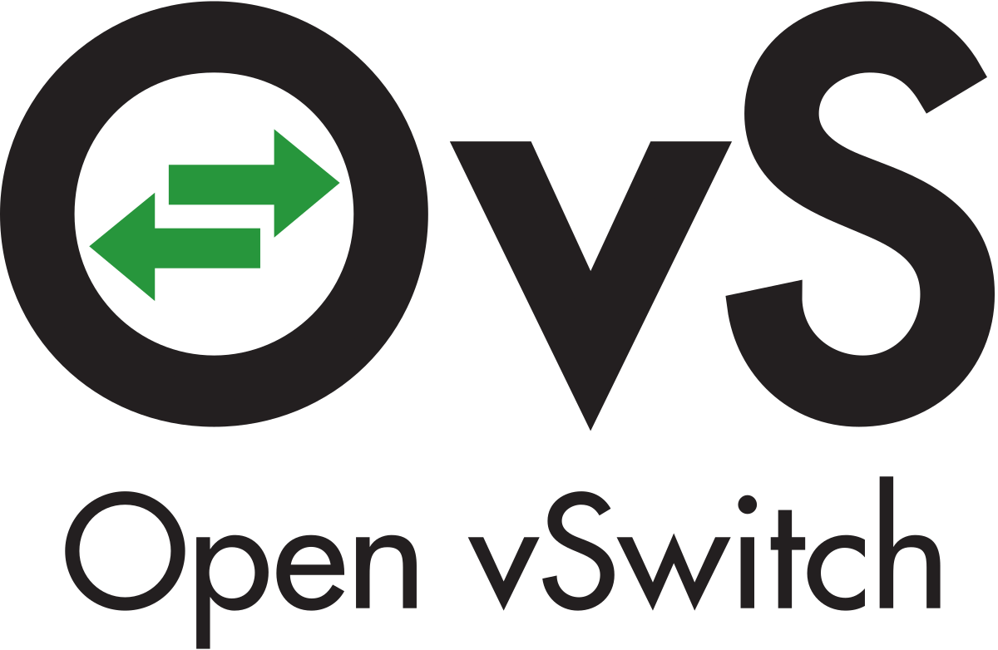
Third-party CNI Plugins for Pod Networking
Amazon ECS
Calico
Cillium
Contiv
Contrail
Flannel
GCE
kube-router
Multus
OpenVSwitch
Romana
Weave Net
Notes:
Just a subset, circa Feb 2018

Slide 34
Cluster DNS, today CoreDNS
Provides Cluster Wide DNS for Kubernetes Services.
CoreDNS (current default)
kube-dns (default pre-1.13)
Resolves `{name}.{namespace}.svc.cluster.local` queries to the Service Virtual IPs.
Notes:
kube-dns is a wrapper around dnsmasq with another container in the pod that manages its config
CoreDNS is a single golang binary with a slew of plugins and much better native kubernetes support

Slide 35
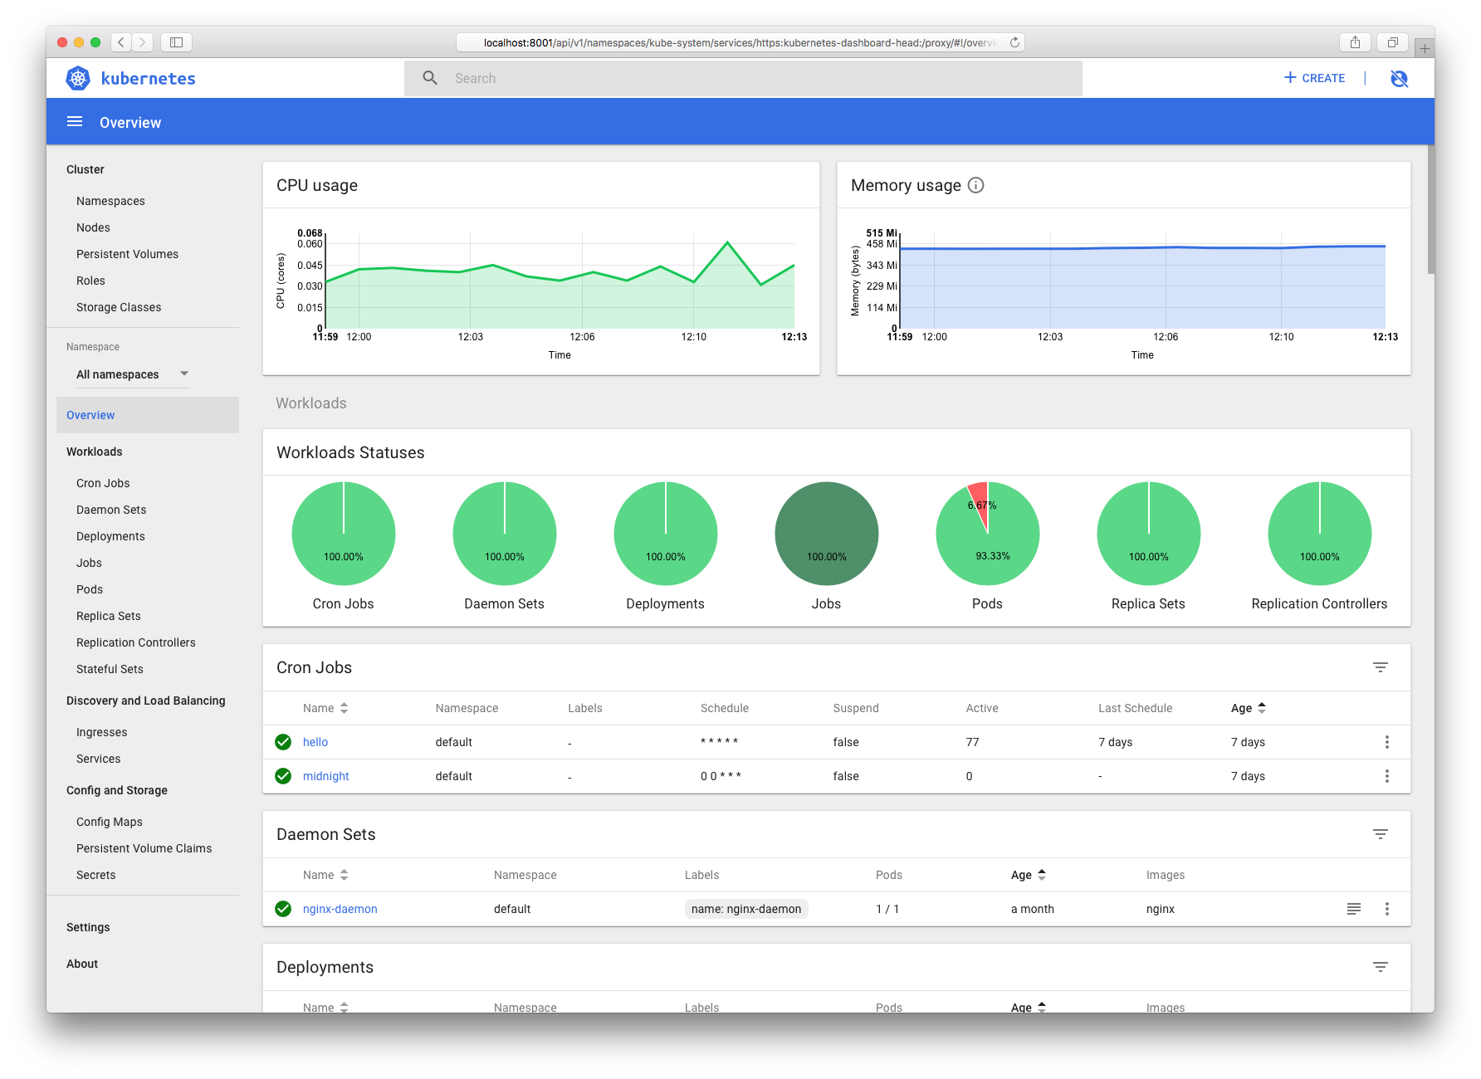
The Kubernetes Dashboard
A limited, general purpose web front end for the Kubernetes Cluster.
Notes:
Useful for quickly getting a picture of the cluster, but no substitute for cli or other tools

Slide 36
Kubernetes’ Essential Concepts
Dive into how to use Kubernetes for real

Slide 37
The core primitive: A Pod
The basic, atomically deployable unit in Kubernetes.
A Pod consists of one or many co-located containers. A Pod represents a single instance of an application.
The containers in a Pod share the loopback interface (localhost) and can share mounted directories.
Each Pod has it’s own, uniquely assigned and internal IP.
Pods are mortal, which means that if the node the Pod runs on becomes unavailable, the workload also goes unavailable.
apiVersion: v1 kind: Pod metadata: name: nginx namespace: default labels: app: nginx spec: containers: - image: nginx:1.13.9 name: nginx ports: - name: http containerPort: 80

Slide 38
A replicated, upgradeable set of Pods: A Deployment
apiVersion: apps/v1 kind: Deployment metadata: labels: app: nginx name: nginx spec: replicas: 3 selector: matchLabels: app: nginx template: metadata: labels: app: nginx spec: containers: - image: nginx:1.13.9-alpine name: nginx ports: - name: http containerPort: 80
With a Deployment, you can manage Pods in a declarative and upgradable manner.
Note the replicas field. Kubernetes will make sure that amount of Pods created from the template always are available.
When the Deployment is updated, Kubernetes will perform an rolling update of the Pods running in the cluster. Kubernetes will create one new Pod, and remove an old until all Pods are new.
The Pod Template

Slide 39
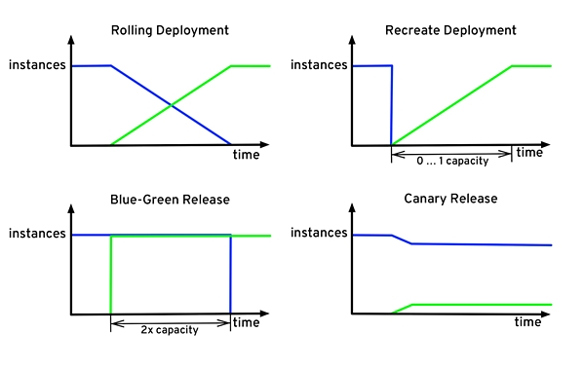
Various possible Deployment upgrade strategies
The built-in Deployment behavior
The other strategies can be implemented fairly easily by talking to the API.
Picture source: Kubernetes effect by Bilgin Ibryam

Slide 40
Access your replicated Pods via a Service
A Service exposes one or many Pods via a stable, immortal, internal IP address.
It’s also accessible via cluster-internal DNS: {service}.{namespace}.svc.cluster.local, e.g. nginx.default.svc.cluster.local
The Service selects Pods based on the label key-value selectors (here app=nginx)
A Service may expose multiple ports. This ClusterIP can be declaratively specified, or dynamically allocated.
apiVersion: v1 kind: Service metadata: name: nginx namespace: default labels: app: nginx spec: type: ClusterIP ports: - name: http port: 80 targetPort: 80 selector: app: nginx
The Pod Selector

Slide 41
Expose your Service to the world with an Ingress
A Service is only accessible inside of the cluster.
In order to expose the Service to the internet, you must deploy an Ingress controller, like Traefik, and create an Ingress Rule
The Ingress rule is the Kubernetes-way of mapping hostnames and paths from internet requests to cluster-internal Services.
The Ingress controller is a loadbalancer that’s creating forwarding rules based on the Ingress Rules in the Kubernetes API.
apiVersion: extensions/v1beta1 kind: Ingress metadata: name: nginx namespace: default labels: app: nginx spec: rules: - host: nginx.demo.kubernetesfinland.com http: paths: - path: / backend: serviceName: nginx servicePort: 80
The Service reference

Slide 42

Isolate your stuff in a Namespace
Internet
nginx.demo.kubernetesfinland.com
A Namespace is a logical isolation method, most resources are namespace-scoped.
You can group logically similar workloads in one namespace and enforce different policies.
You can e.g. have one namespace per team, and let them play in their own virtual environment.
Role Based Access Control (RBAC) can be used to control what Kubernetes users can do, and what resources in what namespaces an user can access is one of the parameters to play with there.
Traefik as Ingress Controller
Namespace: default
nginx Ingress Rule
nginx Service
nginx Pod 1
nginx Pod 2
nginx Pod 3
nginx Deployment

Slide 43
Getting started with your environment

Slide 44

Our online training sponsor is Weaveworks
Weaveworks (https://weave.works) is an official sponsor of this event and is providing the infrastructure for the training.
Weaveworks is a startup based in London, SF, Berlin, and with distributed teams. Our founders and engineers were the creators of RabbitMQ and now run a company with Kubernetes expertise.
Weaveworks has been running Kubernetes in production for about 4 years, our CEO Alexis Richardson is chair of the TOC for the CNCF, and we contribute to the Kubernetes through code, SIGs, and through community work. We have open source projects such as Weave Net, Weave Flux, Weave Scope, Weave Cortex, Weave Flagger, eksctl, and more.
Weaveworks offers Kubernetes and GitOps consulting and training, and it sells Weave Cloud (which includes hosted Prometheus), and a Weave Kubernetes Distribution.

Slide 45


Our online training sponsor is DigitalOcean
A supporter of
our community

Slide 46
Log in to your environment
A cluster with one node has been pre-provisioned using DigitalOcean’s Kubernetes for each workshop participant. This means everyone has their own playground environment to use.

Slide 47
Log in to your environment
Each cluster runs a Visual Studio Code web server, with utilities like kubectl and helm pre-installed. The web server is exposed through a public LoadBalancer, with Let’s Encrypt-issued certs.

Slide 48
Log in to your environment
Log in to your personal environment using the URL: https://cluster-XX.gke-workshopctl.kubernetesfinland.com (where XX is your personal number)
Login passphrase: “kubernetesrocks”

Slide 49

Your environment
Application code
Cluster shell

Slide 50
Set up environment
File -> Open Folder: /home/coder/project
Terminal -> New Terminal
git clone https://github.com/cloud-native-nordics/workshopctl

Slide 51
Getting started
Dive into how to use Kubernetes for real

Slide 52


Workshop resources repository on GitHub
https://github.com/cloud-native-nordics/workshopctl

Slide 53


When you’re stuck: check out the docs!
Whenever you see the button, you can click it to browse the relevant part of the official docs.
docs

Slide 54
Running your first kubectl commands (1/2)
Get the cluster version:
$ kubectl version
See all the workloads (Pods) running in the cluster:
$ kubectl get pods --all-namespaces
See all the most commonly-used resources in the cluster:
$ kubectl get all --all-namespaces
docs

Slide 55
Running your first kubectl commands (2/2)
Let kubectl tell you the structure of an object:
$ kubectl explain --recursive=false Pod
See information about the nodes in the cluster:
$ kubectl describe nodes
docs
Notes:
TODO:
See resource usage for nodes and workloads:
$ kubectl top nodes
$ kubectl top pods

Slide 56
Running your first application using kubectl (1/3)
Run an image with three replicas, and expose port 9898 :
$ kubectl run podinfo \ --image stefanprodan/podinfo:3.1.2 \ --replicas 3 \ --expose --port 9898
Under the hood, these imperative commands will create both a Deployment and a Service, and connect them with the app=podinfo label.
docs

Slide 57
Running your first application using kubectl (2/3)
Check the status of the workloads:
$ kubectl get deployments,pods,services -owide
$ kubectl logs --timestamps -l run=podinfo
You will see that every pod has its own IP, and that the service has it’s own internal IP as well. You can try to curl the IP, and see that it responds, and different replicas every time (round-robin loadbalancing).
$ watch "curl -s podinfo.default:9898 | grep hostname"
$ curl podinfo.default.svc.cluster.local:9898
docs
Notes:
Maybe need to be workshopctl here

Slide 58
Running your first application using kubectl (3/3)
Scale the deployment to 5 replicas:
$ kubectl scale deployment/podinfo --replicas 5
$ kubectl get all -owide
You should now see the Deployment contains 5 Pod replicas. Check out the Pod IPs that the service targets:
$ kubectl get endpoints
You may also exec into a Pod directly using:
$ kubectl exec -it podinfo-xxxx-yyyy /bin/sh
docs

Slide 59
Running your first application using kubectl
Cleanup :
$ kubectl delete deployment podinfo
$ kubectl delete service podinfo
docs

Slide 60
Going declarative!

Slide 61

API Overview
The REST API is the true keystone of Kubernetes.
Everything within the Kubernetes is as an API Object.
Image Source
Notes:
API-Server is the keystone to Kubernetes
Every component communicates with it
Everything created within Kubernetes is an API object or resource
This is object-oriented application architecture

Slide 62
API Groups
Format:
/apis/<group>/<version>/<resource>
Examples:
/apis/apps/v1/deployments
/apis/batch/v1beta1/cronjobs
Designed to make it extremely simple to both understand and extend.
An API Group is a REST compatible path that acts as the type descriptor for a Kubernetes object.
Referenced within an object as the apiVersion and kind.
Notes:
Every object in kubernetes belongs to an API Group
The API Group is a REST compatible path that acts as the type descriptor for a Kubernetes object.
apiVersion is the version of the object we’re creating
kind is the specific type of object or resource being created

Slide 63
API Versioning
Format:
/apis/<group>/<version>/<resource>
Examples:
/apis/apps/v1/deployments
/apis/batch/v1beta1/cronjobs
Three tiers of API maturity levels.
Also referenced within the object’s apiVersion.
Alpha: Possibly buggy, And may change. Disabled by default.
Beta: Tested and considered stable. However API Schema may change slightly. Enabled by default.
Stable: Released, stable and API schema will not change. Enabled by default.
Notes:
Note on how to enable disabled (alpha) features

Slide 64
Object Model
Objects are a “record of intent” or a persistent entity that represent the desired state of the object within the cluster.
All objects MUST have apiVersion, kind, and posess the nested fields metadata.name, metadata.namespace, and metadata.uid.
Notes:
Record of intent may sound odd, but here’s another way of looking at it.
If you order pizza for delivery, you have specified clearly what you want delivered.
This establishes the type of object, the version of the object and a unique identity for the object itself
HOWEVER when defining an object, many fields are optional (namespace can be inherited. UID can be generated)

Slide 65
Object Model Requirements
apiVersion: Kubernetes API version of the Object
kind: Type of Kubernetes Object
metadata.name: Unique name of the Object
metadata.namespace: Scoped environment name that the object belongs to (will default to current).
metadata.uid: The (generated) uid for an object.
apiVersion: v1
kind: Pod
metadata:
name: pod-example namespace: default
uid: f8798d82-1185-11e8-94ce-080027b3c7a6

Slide 66
Object Expression - YAML Example
apiVersion: v1
kind: Pod
metadata:
name: yaml
namespace: default
spec:
containers:
- name: container1
image: nginx
- name: container2
image: alpine
Notes:
Super simple example

Slide 67
Object Expression - YAML Example
apiVersion: v1
kind: Pod
metadata:
name: yaml
namespace: default
spec:
containers:
- name: container1
image: nginx
- name: container2
image: alpine
Scalar
Mapping Hash Dictionary
Sequence Array List

Slide 68
YAML vs JSON
apiVersion: v1
kind: Pod
metadata:
name: pod-example
spec:
containers:
- name: nginx
image: nginx:stable-alpine
ports:
- containerPort: 80
{
"apiVersion": "v1",
"kind": "Pod",
"metadata": {
"name": "pod-example"
},
"spec": {
"containers": [
{
"name": "nginx",
"image": "nginx:stable-alpine",
"ports": [ { "containerPort": 80 } ]
}
]
}
}

Slide 69
Object Model - Workloads
Workload related objects within Kubernetes have an additional two nested fields: spec and status.
spec - Describes the desired state or configuration of the object to be created.
status - Is managed by Kubernetes and describes the actual state of the object and its history.

Slide 70
Workload Object Example
Example Object
apiVersion: v1
kind: Pod
metadata:
name: pod-example
spec:
containers:
- name: nginx
image: nginx:stable-alpine
ports:
- containerPort: 80
Example Status Snippet
status:
conditions:
- lastProbeTime: null
lastTransitionTime: 2018-02-14T14:15:52Z
status: "True"
type: Ready
- lastProbeTime: null
lastTransitionTime: 2018-02-14T14:15:49Z
status: "True"
type: Initialized
- lastProbeTime: null
lastTransitionTime: 2018-02-14T14:15:49Z
status: "True"
type: PodScheduled

Slide 71

Labels
key-value pairs that are used to identify, describe and group together related sets of objects or resources.
NOT characteristic of uniqueness.
Have a strict syntax with a slightly limited character set*.
* https://kubernetes.io/docs/concepts/overview/working-with-objects/labels/#syntax-and-character-set

Slide 72
Label Example
apiVersion: v1
kind: Pod
metadata:
name: pod-label-example
labels: app: nginx env: prod
spec:
containers:
- name: nginx
image: nginx:stable-alpine
ports:
- containerPort: 80

Slide 73
Selectors
apiVersion: v1
kind: Pod
metadata:
name: pod-label-example
labels: app: nginx env: prod
spec:
containers:
- name: nginx
image: nginx:stable-alpine
ports:
- containerPort: 80 nodeSelector:
gpu: nvidia
Selectors use labels to filter or select objects, and are used throughout Kubernetes.
Notes:
Selectors allow you to create rules based on your labels
NO ‘hard links’ to things, everything is done through labels and selectors

Slide 74

Pod NodeSelector Example
apiVersion: v1
kind: Pod
metadata:
name: pod-label-example
labels: app: nginx env: prod
spec:
containers:
- name: nginx
image: nginx:alpine
ports:
- containerPort: 80 nodeSelector:
gpu: nvidia

Slide 75
Selector Types
Equality based selectors allow for simple filtering (== or !=).
Set-based selectors are supported on a limited subset of objects. However, they provide a method of filtering on a set of values, and supports multiple operators including: in, notin, and exist.
selector:
matchLabels:
gpu: nvidia
selector:
matchExpressions:
- key: gpu
operator: in
values: [“nvidia”]

Slide 76
Deploying your first app declaratively
Dive into how to use Kubernetes for real

Slide 77
Generate YAML specifications with kubectl
In the previous interactive section, we deployed an application imperatively, by using kubectl.
The much better way of working is to write down the desired state in a file, and declaratively tell Kubernetes what to do.
You can generate the skeleton YAML files by running:
$ kubectl create --dry-run -o=yaml [resource]
$ alias kube-yaml="kubectl -n demo create --dry-run -o=yaml"
Notes:
kubectl create namespace demo --dry-run -oyaml > namespace.yaml
kubectl -n demo create --dry-run -o=yaml deployment --image stefanprodan/podinfo:3.1.2 podinfo > deployment.yaml
kubectl -n demo create --dry-run -o=yaml service clusterip podinfo --tcp 80:9898 > service.yaml
echo '{ "amazing": true }' > my-config-file.json
kubectl -n demo create --dry-run -o=yaml configmap podinfo --from-literal IS_KUBERNETES_FINLAND=true --from-file my-config-file.json > configmap.yaml
kubectl -n demo create --dry-run -o=yaml secret generic podinfo --from-literal SECRET_PASSWORD=Passw0rd1 > secret.yaml

Slide 78
Workspace
Create a new directory in VS code called workshop-2. For each new YAML file you’re creating, name it after the object’s Kind (e.g. Deployment -> deployment.yaml).
If you get stuck, you can look at the correctly-created reference files in tutorials/podinfo.
Notes:
kubectl create namespace demo --dry-run -oyaml > namespace.yaml
kubectl -n demo create --dry-run -o=yaml deployment --image stefanprodan/podinfo:3.1.2 podinfo > deployment.yaml
kubectl -n demo create --dry-run -o=yaml service clusterip podinfo --tcp 80:9898 > service.yaml
echo '{ "amazing": true }' > my-config-file.json
kubectl -n demo create --dry-run -o=yaml configmap podinfo --from-literal IS_KUBERNETES_FINLAND=true --from-file my-config-file.json > configmap.yaml
kubectl -n demo create --dry-run -o=yaml secret generic podinfo --from-literal SECRET_PASSWORD=Passw0rd1 > secret.yaml

Slide 79
Dedicate a namespace for your work
apiVersion: v1
kind: Namespace
metadata:
name: demo
In the following exercise, we’re gonna solely use the demo namespace. Generate the YAML like this and save it to a file (null and {} field may be omitted from the resulting file.):
$ kube-yaml namespace demo > namespace.yaml

Slide 80
Generate a Deployment spec for your workload
$ kube-yaml deployment \ --image stefanprodan/podinfo:3.1.2 \ podinfo
Notes:
the app=podinfo label is consistently used across the Deployment itself, its Pod Selector, and the Pod Template.
this workload is now placed in the demo namespace.
edit the Deployment to have 3 replicas.
apiVersion: apps/v1
kind: Deployment
metadata:
labels:
app: podinfo
name: podinfo
namespace: demo
spec:
replicas: 3
selector:
matchLabels:
app: podinfo
template:
metadata:
labels:
app: podinfo
spec:
containers:
- image: stefanprodan/podinfo:3.1.2
name: podinfo
Notes:
apiVersion: apps/v1
kind: Deployment
metadata:
labels:
app: podinfo
name: podinfo
namespace: demo
spec:
replicas: 1
selector:
matchLabels:
app: podinfo
template:
metadata:
labels:
app: podinfo
spec:
containers:
- image: stefanprodan/podinfo:3.1.2
name: podinfo

Slide 81
Create a Service that matches app=podinfo
apiVersion: v1
kind: Service
metadata:
labels:
app: podinfo
name: podinfo
namespace: demo
spec:
ports:
- name: 80-9898
port: 80
protocol: TCP
targetPort: 9898
selector:
app: podinfo
type: ClusterIP
Create a Service that routes traffic to all Pods with the app=podinfo label.
port specifies on what port the Service is accessible on, while targetPort specifies on what port the Pod exposes.
$ kube-yaml service clusterip \ podinfo --tcp 80:9898

Slide 82
Common PodSpec options
Overrides ENTRYPOINT
spec:
containers:
- image: stefanprodan/podinfo:3.1.2
name: podinfo
command:
- ./podinfo
- --config-path=/configmap
# Alternatively, only specify args
# if you want to use the default
# ENTRYPOINT of the image
args:
- --config-path=/configmap
env:
- name: PRODUCTION
value: "true"
With command or args, you may customize what parameters the container is run with. command overrides the image’s default entrypoint, while args doesn’t
You can also easily set customized environment variables with env
Doesn’t override ENTRYPOINT

Slide 83
Add best-practice Resource Requests and Limits
In order to restict the amount of resources a workload may consume from the host, it’s a best-practice pattern to set resource requests and limits.
This to avoid the “noisy neighbour” issue
When setting the requests equal to the limits the workload is put in the Guaranteed class
spec:
containers:
- image: stefanprodan/podinfo:3.1.2
name: podinfo
resources:
requests:
memory: "32Mi"
cpu: "10m"
limits:
memory: "32Mi"
cpu: "10m"
docs

Slide 84
Store your configuration in a ConfigMap
With a ConfigMap you can let environment-specific data be injected at runtime either as files on disk or as environment variables.
apiVersion: v1
kind: ConfigMap
metadata:
name: podinfo
namespace: demo
data:
IS_KUBERNETES_FINLAND: "true"
my-config-file.json: |
{ "amazing": true }
$ echo '{ "amazing": true }' > /tmp/my-config-file.json
$ kube-yaml configmap podinfo \
--from-literal IS_KUBERNETES_FINLAND=true \
--from-file /tmp/my-config-file.json
docs

Slide 85
Mount a ConfigMap in a Pod
containers:
- image: stefanprodan/podinfo:3.1.2
name: podinfo
env:
- name: IS_KUBERNETES_FINLAND
valueFrom:
configMapKeyRef:
name: podinfo
key: IS_KUBERNETES_FINLAND
volumeMounts:
- name: configmap-projection
mountPath: /configmap
volumes:
- name: configmap-projection
configMap:
name: podinfo
Expose an env var
You can either expose the contents of a ConfigMap via environment variables in the workload, or by projecting the contents as files on disk.
Project contents to disk
docs

Slide 86
Store your secret values in a Secret
A Secret is like a ConfigMap, but provides better security guarantees. Secrets can be encrypted at REST and in etcd, and won’t ever be written to disk (but stored in RAM).
$ kube-yaml secret generic \
podinfo \
--from-literal APP_PASSWORD=Passw0rd1
apiVersion: v1
kind: Secret
metadata:
name: podinfo
namespace: demo
data:
APP_PASSWORD: UGFzc3cwcmQx

Slide 87
Mount a Secret in a Pod
containers:
- image: stefanprodan/podinfo:3.1.2
name: podinfo
env:
- name: APP_PASSWORD
valueFrom:
secretKeyRef:
name: podinfo
key: APP_PASSWORD
volumeMounts:
- name: secret-projection
mountPath: /secret
volumes:
- name: secret-projection
secret:
secretName: podinfo
Expose an env var
You may expose the contents of a Secret via both environment variables and the filesystem, but note that use of env vars is discouraged.
Project contents to disk
docs

Slide 88
Add best-practice Liveness and Readiness Probes
containers:
- image: stefanprodan/podinfo:3.1.2
name: podinfo
readinessProbe:
httpGet:
path: /readyz
port: 9898
initialDelaySeconds: 1
periodSeconds: 5
failureThreshold: 1
livenessProbe:
httpGet:
path: /healthz
port: 9898
initialDelaySeconds: 1
periodSeconds: 10
failureThreshold: 2
A liveness probe specifies whether the workload is healthy or not. If not, the container will be restarted.
A readiness probe tells Kubernetes whether the Pod is ready to serve traffic. If not, its endpoint will be removed from any Services it belongs to.
Can the Pod serve traffic?
Should the Pod be restarted?

Slide 89
Expose your Service with an Ingress
apiVersion: extensions/v1beta1
kind: Ingress
metadata:
name: podinfo
namespace: demo
spec:
rules:
- host: podinfo.cluster-XX.gke-workshopctl.kubernetesfinland.com
http:
paths:
- path: /
backend:
serviceName: podinfo
servicePort: 80
With an Ingress you can route a public endpoint to a Service available inside the cluster.
Here, route /podinfo of your domain to the podinfo Service.
Note that an Ingress controller needs to be running in the cluster. (We’re using Traefik)

Slide 90
Testing the result
You should now have the namespace.yaml, deployment.yaml, service.yaml, configmap.yaml, secret.yaml and ingress.yaml files available on disk.
Tell Kubernetes to make this desired state the actual state with:
$ kubectl apply -f .
After a while, open a new tab and check out the /podinfo endpoint of your domain. You should see the UI of podinfo.

Slide 91
Testing the result
For all kubectl commands from now on, add the flag "-n demo" directly after kubectl. This tells it to use the demo namespace. Note: “-n demo” will be omitted for brevity further down the road.
$ kubectl -n demo get all
$ kubectl -n demo get configmaps -o=yaml

Slide 92
Testing the result
We will now test that the Pod endpoint for the podinfo Service is removed when the Readiness probe fails.
$ kubectl get endpoints # Expecting 3 endpoints for podinfo
$ curl -X POST podinfo.demo/readyz/disable
$ kubectl get endpoints # Expecting 2 endpoints for podinfo
$ kubectl get pods -o wide # Find the Pod IP that got disabled
$ curl -X POST 10.x.x.x:9898/readyz/enable
$ kubectl get endpoints # Expecting 3 endpoints for podinfo

Slide 93
Monitoring, visualization and extensibility
Dive into how to use Kubernetes for real

Slide 94
Check out the Kubernetes Dashboard
Next up we will check out the official Kubernetes Dashboard. Go to /dashboard/ (note the trailing slash) of your unique domain, and you should see a login page. You can get the token from here:
$ cat /var/run/secrets/kubernetes.io/serviceaccount/token && echo

Slide 95
Extend your cluster with CustomResourceDefinitions
A CRD is an arbitrary Kubernetes-like object stored in the API server. This allows for very powerful Kubernetes-native management of complex applications.
An operator uses CRDs to know how to operate on a complex application (like Prometheus).

Slide 96
Check out Prometheus
Prometheus has been installed by default. You can access it on the /prometheus endpoint of your domain.

Slide 97
Check out Grafana
Grafana has been installed by default. You can access it on the /grafana endpoint of your domain.
Log in with admin / prom-operator.

Slide 98
Start monitoring your podinfo Service
apiVersion: monitoring.coreos.com/v1
kind: ServiceMonitor
metadata:
labels:
app: podinfo
release: k8sfin
name: podinfo
namespace: demo
spec:
endpoints:
- port: 80-9898
jobLabel: app
namespaceSelector:
matchNames:
- demo
selector:
matchLabels:
app: podinfo
By creating a ServiceMonitor CustomResource that the Prometheus Operator understands, we can tell it to dynamically monitor our podinfo application.
The ServiceMonitor adds the endpoints of all Services with label app=podinfo, using the 80-9898-named port.

Slide 99
Querying Prometheus for data
https://github.com/stefanprodan/k8s-podinfo/blob/master/docs/3-monitoring.md has some good sample queries.
http_requests_total{job="podinfo"}
sum(http_requests_total{job="podinfo"}) by (instance)
rate(http_requests_total{job="podinfo"}[1m])
sum(rate(http_requests_total{job="podinfo"}[1m])) by (instance)
histogram_quantile(0.99, sum(rate(http_request_duration_seconds_bucket{job="podinfo"}[1m])) by (le))

Slide 100
Querying Prometheus for data
# Average request duration over latest 10 mins
sum(rate(http_request_duration_seconds_sum{job="podinfo"}[10m])) /
sum(rate(http_request_duration_seconds_count{job="podinfo"}[10m]))
# Number of goroutines, total and per instance
sum(go_goroutines{job="podinfo"})
sum(go_goroutines{job="podinfo"}) by (instance)
# Memory usage, total and per instance
sum(go_memstats_alloc_bytes{job="podinfo"})
avg(go_memstats_alloc_bytes{job="podinfo"}) by (instance)

Slide 101
Final exercise

Slide 102

Challenge!

Slide 103
Reference Slide Deck
Introduction to Kubernetes by Bob Killen and Jeffrey Sica

Slide 104
Thank you!
@luxas on Github
@luxas on Kubernetes’ Slack
@kubernetesonarm on Twitter
lucas@luxaslabs.com

